Slide 1
Lecture 4
Normal Equations

Slide 2
Introduction
Previously we learned how to fit a linear model to data
In this lecture we present an alternative way to solve this problem which is simpler and more efficient to implement
Notes:
Previously we learned how to fit a linear model to data
In this lecture we present an alternative way to solve this problem which is simpler and more efficient to implement
It is however a more abstract way to approach the problem.
As we will see later, the method is the basis of several machine learning algorithms

Slide 3
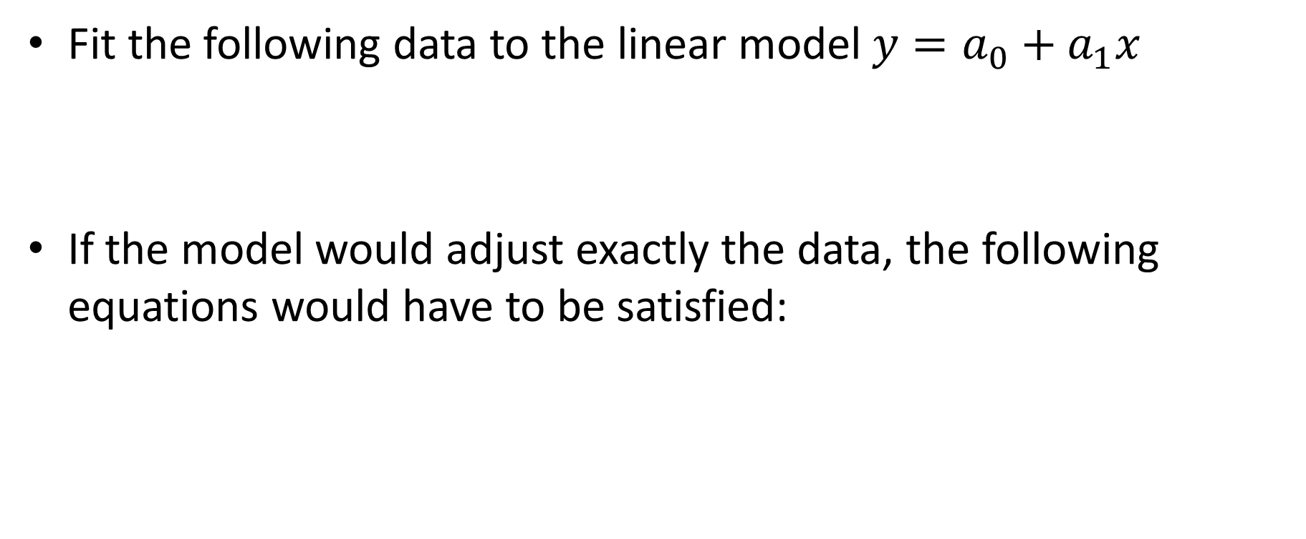



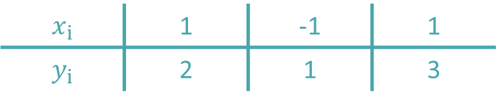
Curve fitting as set of inconsistent equations
Fit the following data to the linear model ${y=a}_{0}+a_{1}x$
If the model would adjust exactly the data, the following equations would have to be satisfied:
$$x_{i}$$ | 1 | -1 | 1
$$y_{i}$$ | 2 | 1 | 3
$${2=a}_{0}+a_{1}$$
$${1=a}_{0}−a_{1}$$
$${3=a}_{0}+a_{1}$$
$$\left[\begin{matrix}1 & 1 \\ 1 & −1 \\ 1 & 1\end{matrix}\right]\left[\begin{matrix}a_{0} \\ a_{1}\end{matrix}\right]=\left[\begin{matrix}2 \\ 1 \\ 3\end{matrix}\right]$$
$$A\underline{a}=\underline{b}$$
Notes:
To introduce this alternative approach, we consider an example of a data set with three points and a linear model
Imagine for an instant that the model could adjust exactly the data set
If that would be the case then the prediction for each point xi of the model would match exactly the corresponding yi
For example for the first point we would have that
ao plus one times a1 must be equal to 2
Same type of relation can be written for the remaining data points to result in the displayed linear system of equations.
This system has two unknowns ao and a1
The system contains however three equations, which is more than the number of unknowns
In general it will not be possible to solve this system of equations
A system with more equations than unknown is called a inconsistent system of equations
As for any other linear system of equation, it is more efficient to write it in matrix form
Note that we denote the vector of unknowns by the vector a as the unknowns are ao and a1.
Note as well that, contrary to the case where the number of equations matches the number of unknowns, the coefficient matrix is no longer a square matrix.
In our case we have a 3 by 2 matrix

Slide 4
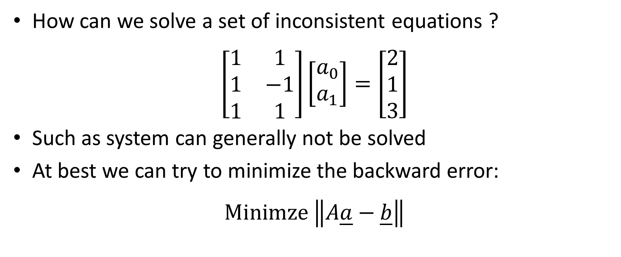
Solving inconsistent equations
How can we solve a set of inconsistent equations ?
$$\left[\begin{matrix}1 & 1 \\ 1 & −1 \\ 1 & 1\end{matrix}\right]\left[\begin{matrix}a_{0} \\ a_{1}\end{matrix}\right]=\left[\begin{matrix}2 \\ 1 \\ 3\end{matrix}\right]$$
Such as system can generally not be solved
At best we can try to minimize the backward error:
$$\text{Minimze} \left\|A\underline{a}−\underline{b}\right\|$$
Notes:
The question that we have at hand is: how can we solve a system of inconsistent equations?
As mentioned, in general such as system can of course not be solved
At best we can minimize the backward error

Slide 5






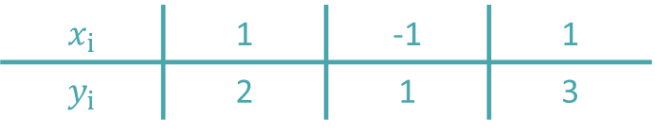
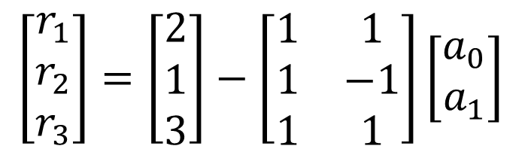
Backward error and residuals
The backward error $\left\|A\underline{a}−\underline{b}\right\|$ is in fact linked to the residuals:
$${r_{i}=y}_{i}−a_{0}−a_{1}x_{i}$$
$$\underline{r}=\underline{b}−A\underline{a}$$
$$x_{i}$$ | 1 | -1 | 1
$$y_{i}$$ | 2 | 1 | 3
$${r_{1}=2−a}_{0}−a_{1}$$
$$\left[\begin{matrix}r_{1} \\ r_{2} \\ r_{3}\end{matrix}\right]=\left[\begin{matrix}2 \\ 1 \\ 3\end{matrix}\right]−\left[\begin{matrix}1 & 1 \\ 1 & −1 \\ 1 & 1\end{matrix}\right]\left[\begin{matrix}a_{0} \\ a_{1}\end{matrix}\right]$$
$${r_{2}=1−a}_{0}+a_{1}$$
$${r_{3}=3−a}_{0}−a_{1}$$
Notes:
The key point to understand is that in fact the backward error is the vector made out of the residuals we defined in regression
Recall that the residuals are the difference between the data point and the model prediction.
For our linear model that is yi minus ao minus a1 times xi
On the other hand the backward error is the norm of the vector r which is the difference between the right hand side vector b and the vector A times a
Let us compare these two expressions in the case of our example.
We will realize that in fact they are the same
We start with our data points
From the data points and the linear model we can write down the residuals
On the other side, we can write down the expression of the vector r.
Comparing the equations on the left and on the right, it is now straight forward to realize that indeed we have here exactly the same quantities

Slide 6
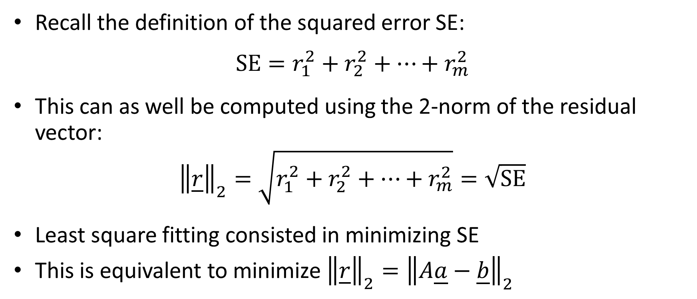
Backward error and squared error
Recall the definition of the squared error SE:
$$\text{SE}=r_{1}^{2}+r_{2}^{2}+…+r_{m}^{2}$$
This can as well be computed using the 2-norm of the residual vector:
$${\left\|\underline{r}\right\|}_{2}=\sqrt{r_{1}^{2}+r_{2}^{2}+…+r_{m}^{2}}=\sqrt{\text{SE}}$$
Least square fitting consisted in minimizing SE
This is equivalent to minimize ${\left\|\underline{r}\right\|}_{2}={\left\|A\underline{a}−\underline{b}\right\|}_{2}$
Notes:
Having realized that the residuals can be computed by calculating the backward error of the set of inconsistent equations, we can go a step further and compute the squared error
Recall that the squared error is defined as the sum of the square of all residuals
That is nothing else than the square of the 2–norm of the vector r.
Now, as least square fitting consist in minimizing the squared error SE this is equivalent to minimize the 2-norm of the backward error of the inconsistent system of equations.

Slide 7

Fitting a model by least square (minimizing the squared error SE) is equivalent to minimize the 2-norm of the backward error of the inconsistent set of equations $A\underline{a}=\underline{b}$ resulting from writing down all equations $y_{i}=a_{0}+a_{1}x_{i}$
Notes:
These observations lead us to the key statement of the present lecture
Fitting a model by least square is equivalent to minimize the 2-norm of the backward error of the inconsistent set of equations resulting from writing down all equations $y_{i}=a_{0}+a_{1}x_{i}$

Slide 8
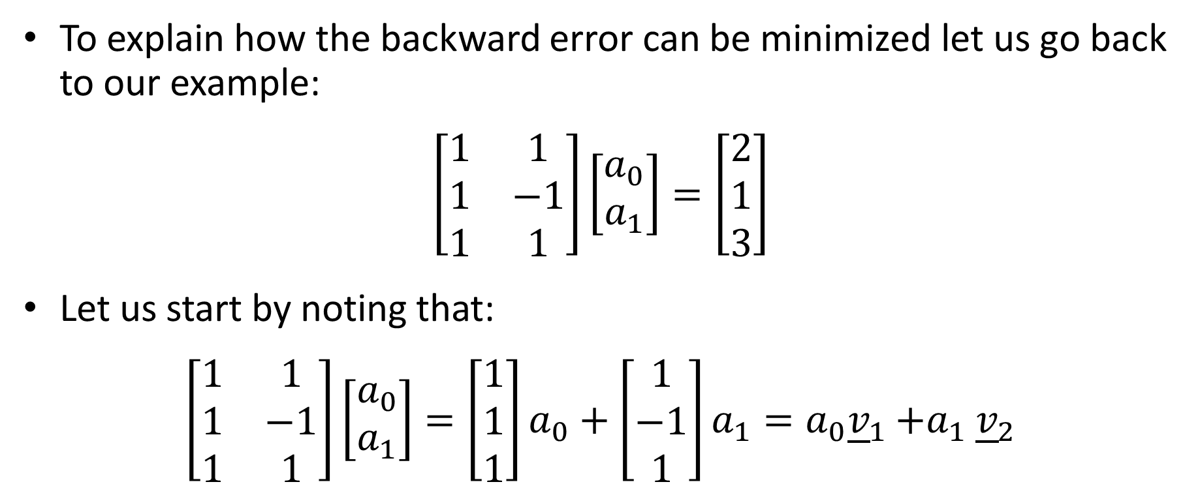
Minimizing backward error
To explain how the backward error can be minimized let us go back to our example:
$$\left[\begin{matrix}1 & 1 \\ 1 & −1 \\ 1 & 1\end{matrix}\right]\left[\begin{matrix}a_{0} \\ a_{1}\end{matrix}\right]=\left[\begin{matrix}2 \\ 1 \\ 3\end{matrix}\right]$$
Let us start by noting that:
$$\left[\begin{matrix}1 & 1 \\ 1 & −1 \\ 1 & 1\end{matrix}\right]\left[\begin{matrix}a_{0} \\ a_{1}\end{matrix}\right]=\left[\begin{matrix}1 \\ 1 \\ 1\end{matrix}\right]a_{0}+\left[\begin{matrix}1 \\ −1 \\ 1\end{matrix}\right]a_{1}=a_{0}{\underline{v}}_{1}{+a}_{1}{\underline{v}}_{2}$$
Notes:
To explain how the backward error can be minimized, let us go back to our example and let us try to solve the system Aa=b of inconsistent equations.
We start by making an observation.
The product between the coefficient matrix A and the vector of unknowns a can be written as a linear combination of two vectors v1 and v2
The vector v1 is the first column of A and v2 is the second column of A
The factors of the linear combinations are ao and a1
Note that this is in fact not specific to our example. It holds for any product between a matrix and a column vector

Slide 9


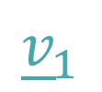
Geometrical interpretation
$${A\underline{a}=a}_{0}{\underline{v}}_{1}{+a}_{1}{\underline{v}}_{2}$$
$${\underline{v}}_{2}$$
$${\underline{v}}_{1}$$
Notes:
What does this tell us?
The two vectors v1 and v2 will spam up a plane
Based on our observation, the vector we obtain by multiplying the coefficient matrix A by the vector of unknowns must be inside this plane.
It is important to realize that for any choice of our model parameters the resulting vector will be in the plane (v1, v2)

Slide 10
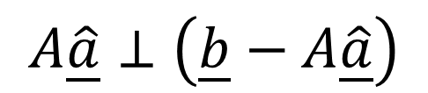
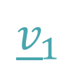



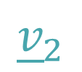
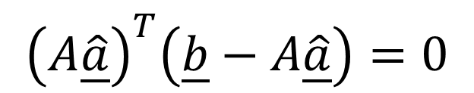
Finding smallest backward error
$$\underline{b}$$
$$\underline{b}−A\underline{\hat{a}}$$
$$A\underline{\hat{a}}$$
$${\underline{v}}_{2}$$
$$A\underline{\hat{a}}⊥\left(\underline{b}−A\underline{\hat{a}}\right)$$
$${\underline{v}}_{1}$$
$${\left(A\underline{\hat{a}}\right)}^{T}\left(\underline{b}−A\underline{\hat{a}}\right)=0$$
Notes:
On the other hand, the vector b will not necessarily be in the plane spanned by v1 and v2
We want to find a vector $\underline{\hat{a}}$ that minimizes the backward error of our inconsistent system of equations.
The backward error will be minimized if the product between the coefficient matrix A and the vector $\underline{\hat{a}}$ is as close as possible to the vector b
That is the orthogonal projection of b onto the plane v1 v2
For such a choice of the vector of unknowns, the backward error vector b-A$\underline{\hat{a}}$ is the shortest possible
We found by geometrical considerations which vector $\underline{\hat{a}}$ will minimize the backward error of the inconsistent system of equations we want to solve
The remarkable consequence of this geometrical method is that we can write down an equation for this situation
We first note that the vector A$\underline{\hat{a}}$ and the vector b-A$\underline{\hat{a}}$ must be perpendicular to each others
That means that their dot product is equal to zero
This is translated by the displayed relation where we have used the transpose of a vector to form the dot product.

Slide 11
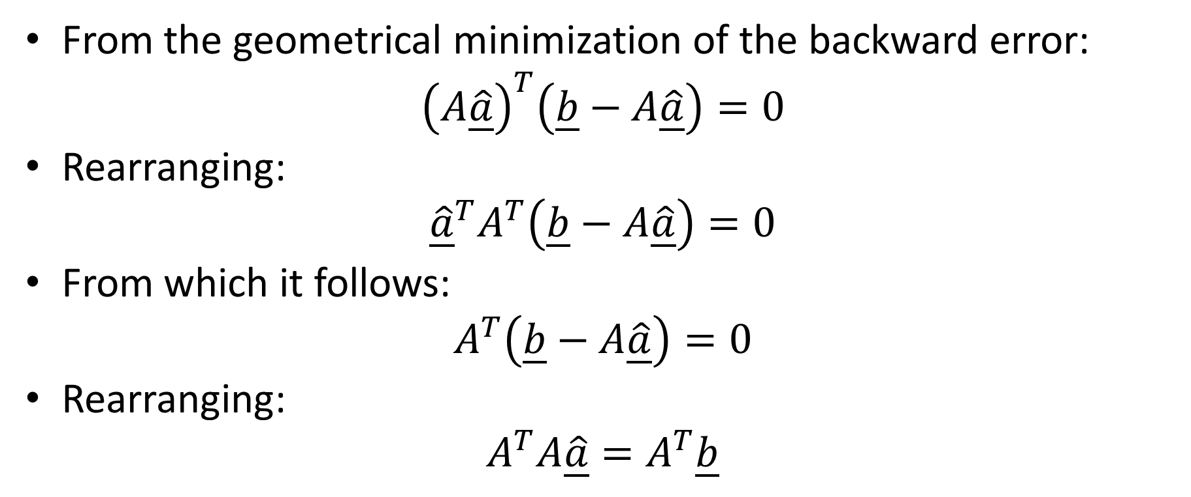
Normal equations
From the geometrical minimization of the backward error:
$${\left(A\underline{\hat{a}}\right)}^{T}\left(\underline{b}−A\underline{\hat{a}}\right)=0$$
Rearranging:
$${\underline{\hat{a}}}^{T}A^{T}\left(\underline{b}−A\underline{\hat{a}}\right)=0$$
From which it follows:
$$A^{T}\left(\underline{b}−A\underline{\hat{a}}\right)=0$$
Rearranging:
$$A^{T}A\underline{\hat{a}}=A^{T}\underline{b}$$
Notes:
We can work out of this relation a more practical one
For this we re-arrange a little our relation by applying the transposition operation to each part of the product individually
The vector $\underline{\hat{a}}$ being none zero and not orthogonal to the vector $A^{T}\left(\underline{b}−A\underline{\hat{a}}\right)$, we can further write that $A^{T}\left(\underline{b}−A\underline{\hat{a}}\right)=$0
Rearranging once more we obtain the equation $A^{T}A\underline{\hat{a}}=A^{T}\underline{b}$
This last equation is called the normal equation
The word “normal” refers here to the fact that the vectors $A\underline{\hat{a}}$ and $\left(\underline{b}−A\underline{\hat{a}}\right)$ are perpendicular, which is the geometrical condition to minimize the backward error

Slide 12

Least square fitting with normal equations
To fit a model by least square:
Write the set of inconsistent equations $A\underline{a}=\underline{b}$ resulting from applying the model to all data points
Solve the normal equations $A^{T}A\underline{a}=A^{T}\underline{b}$ to find the parameters $\underline{\hat{a}}$ of the model which minimize the squared error
Notes:
Based on our calculations we can now formulate the method of least square fitting based on the normal equations
To fit a model by least square we
First write the set of inconsistent equations $A\underline{a}=\underline{b}$ resulting from applying the model to all data points
And second solve the normal equations $A^{T}A\underline{a}=A^{T}\underline{b}$ to find the parameters $\underline{\hat{a}}$ of the model which minimize the squared error

Slide 13

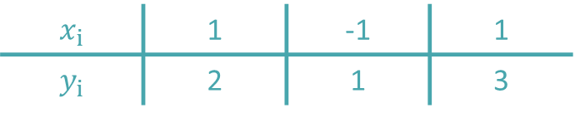
Applied to our example
Data with model ${y=a}_{0}+a_{1}x$
Inconsistent equations:
$$\left[\begin{matrix}1 & 1 \\ 1 & −1 \\ 1 & 1\end{matrix}\right]\left[\begin{matrix}a_{0} \\ a_{1}\end{matrix}\right]=\left[\begin{matrix}2 \\ 1 \\ 3\end{matrix}\right]$$
$$x_{i}$$ | 1 | -1 | 1
$$y_{i}$$ | 2 | 1 | 3
Notes:
Let us illustrate this method by an example
We want to fit a linear model to a set of three data points
First we write down the inconsistent equations by forcing the model to fit exactly each of our data points

Slide 14
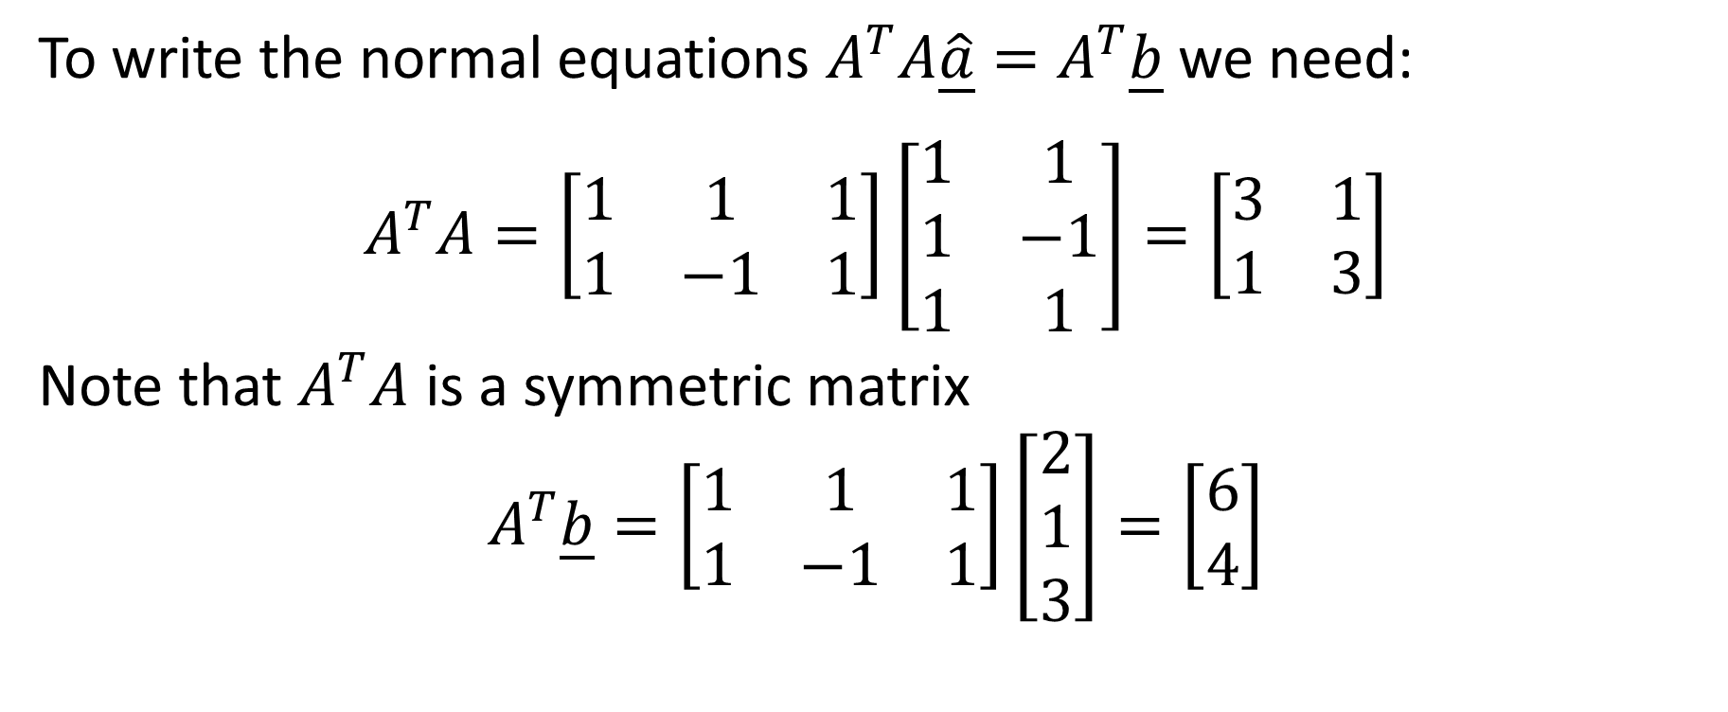
Applied to our example
To write the normal equations $A^{T}A\underline{\hat{a}}=A^{T}\underline{b}$we need:
$$A^{T}A=\left[\begin{matrix}1 & 1 & 1 \\ 1 & −1 & 1\end{matrix}\right]\left[\begin{matrix}1 & 1 \\ 1 & −1 \\ 1 & 1\end{matrix}\right]=\left[\begin{matrix}3 & 1 \\ 1 & 3\end{matrix}\right]$$
Note that $A^{T}A$ is a symmetric matrix
$$A^{T}\underline{b}=\left[\begin{matrix}1 & 1 & 1 \\ 1 & −1 & 1\end{matrix}\right]\left[\begin{matrix}2 \\ 1 \\ 3\end{matrix}\right]=\left[\begin{matrix}6 \\ 4\end{matrix}\right]$$
Notes:
Next we form the normal equations
For this we first calculate the matrix $A^{T}A$. As in our case the matrix A is a 3 by 2 matrix , the matrix $A^{T}A$ will be a 2 by 2 matrix
Note that the matrix is symmetric. This is not an accident. The matrix $A^{T}A$ is always a symmetric matrix.
Can you proof this fact?
As a hint, calculate the transpose of $A^{T}A$ and realize you find again $A^{T}A$. This proofs that $A^{T}A$ is a symmetric matrix.
We further need to calculate the vector $A^{T}\underline{b}$. As $A^{T}$ is a 2 by 3 matrix and the vector b is a column vector with 3 entries, the vector $A^{T}\underline{b}$ will be a column vector with 2 entries

Slide 15


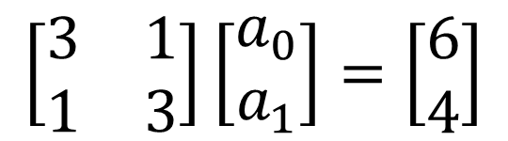
Applied to our example
Solving the normal equations:
$$\left[\begin{matrix}3 & 1 \\ 1 & 3\end{matrix}\right]\left[\begin{matrix}a_{0} \\ a_{1}\end{matrix}\right]=\left[\begin{matrix}6 \\ 4\end{matrix}\right]$$
$$\left[\begin{matrix}a_{0} \\ a_{1}\end{matrix}\right]=\left[\begin{matrix}1.75 \\ 0.75\end{matrix}\right]$$
$$y=1.75+0.75x$$
Notes:
This allows us to write down the normal equations
Note that we obtain a system of two equations for our two unknowns a0 and a1
Solving the system gives us the values for a0 and a1 which will minimize the backward error, or equivalently which will minimize the squared error.
Plotting the resulting model confirms that indeed we found the line passing as good as possible by all data points

Slide 16
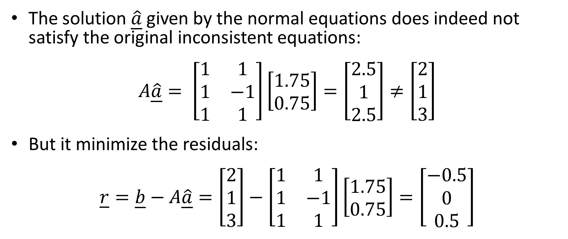
Applied to our example
The solution $\underline{\hat{a}}$ given by the normal equations does indeed not satisfy the original inconsistent equations:
$$A\underline{\hat{a}}= \left[\begin{matrix}1 & 1 \\ 1 & −1 \\ 1 & 1\end{matrix}\right]\left[\begin{matrix}1.75 \\ 0.75\end{matrix}\right]=\left[\begin{matrix}2.5 \\ 1 \\ 2.5\end{matrix}\right]≠\left[\begin{matrix}2 \\ 1 \\ 3\end{matrix}\right]$$
But it minimize the residuals:
$$\underline{r}=\underline{b}−A\underline{\hat{a}}=\left[\begin{matrix}2 \\ 1 \\ 3\end{matrix}\right]−\left[\begin{matrix}1 & 1 \\ 1 & −1 \\ 1 & 1\end{matrix}\right]\left[\begin{matrix}1.75 \\ 0.75\end{matrix}\right]=\left[\begin{matrix}−0.5 \\ 0 \\ 0.5\end{matrix}\right]$$
Notes:
The solution $\underline{\hat{a}}$ we found by solving the normal equations does indeed not satisfy the original inconsistent equations
By plugging it back into the original system we realize that the equations are not satisfied
However, it will minimize the residuals, or backward error, $\underline{b}−A\underline{\hat{a}}$.
Or in simple terms: $\underline{\hat{a}}$ is the least worst solution you can give to the inconsistent system.

Slide 17
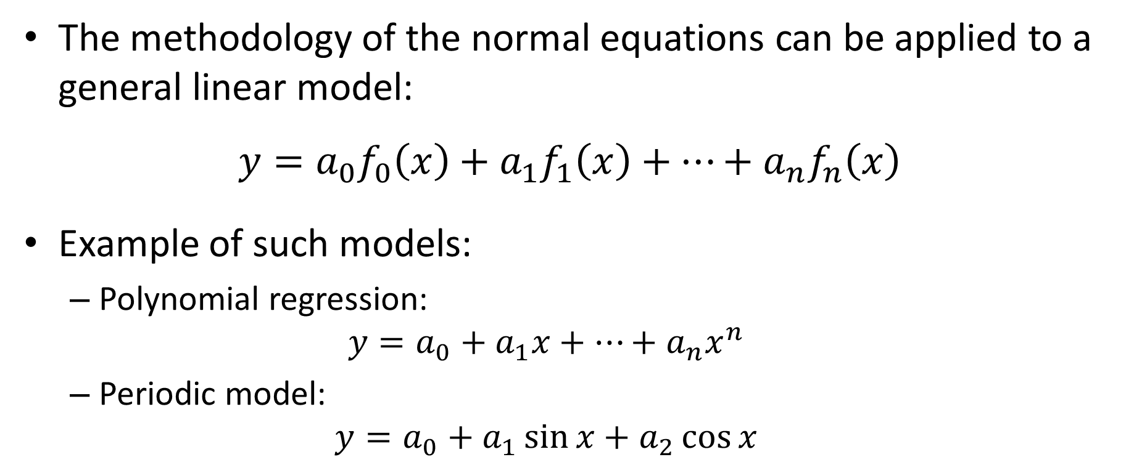
General linear regression
The methodology of the normal equations can be applied to a general linear model:
$${y=a}_{0}f_{0}\left(x\right)+a_{1}f_{1}\left(x\right)+…+a_{n}f_{n}\left(x\right)$$
Example of such models:
Polynomial regression:
$${y=a}_{0}+a_{1}x+…+a_{n}x^{n}$$
Periodic model:
$${y=a}_{0}+a_{1}\sin{x}+a_{2}\cos{x}$$
Notes:
The great advantage of the methodology of the normal equation, is that we can apply it to much more general models than the simple linear model we did handle so far
In fact any model that can be written as a linear combination of some functions fi(x) can be fitted by solving the normal equations
For example polynomial models
Or periodic models

Slide 18

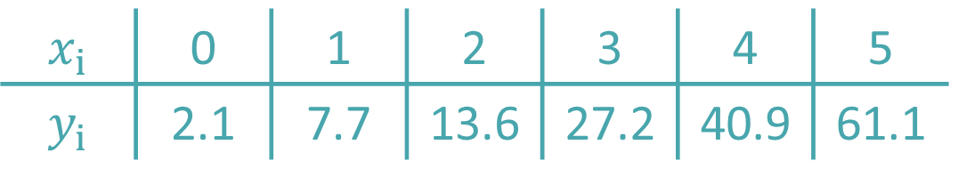
Example
Fit by least square the following data
to the model
$${y=a}_{0}+a_{1}x+a_{2}x^{2}$$
$$x_{i}$$ | 0 | 1 | 2 | 3 | 4 | 5
$$y_{i}$$ | 2.1 | 7.7 | 13.6 | 27.2 | 40.9 | 61.1
Notes:
As an illustration let us fit a polynomial model in second order to a set of 6 data points

Slide 19
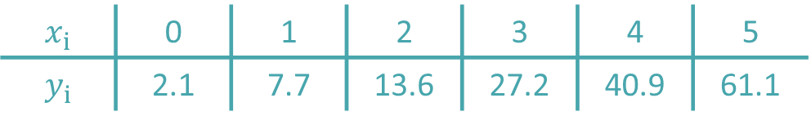


Example – Step 1
Set of non consistent equations:
$$x_{i}$$ | 0 | 1 | 2 | 3 | 4 | 5
$$y_{i}$$ | 2.1 | 7.7 | 13.6 | 27.2 | 40.9 | 61.1
$${2.1=a}_{0}$$
$$7.7=a_{0}+a_{1}+a_{2}$$
$$13.6=a_{0}+2a_{1}+4a_{2}$$
$$27.2=a_{0}+3a_{1}+9a_{2}$$
$$40.9=a_{0}+4a_{1}+16a_{2}$$
$$61.1=a_{0}+5a_{1}+25a_{2}$$
$$\left[\begin{matrix}1 & 0 & 0 \\ 1 & 1 & 1 \\ 1 & 2 & 4 \\ 1 & 3 & 9 \\ 1 & 4 & 16 \\ 1 & 5 & 25\end{matrix}\right]\left[\begin{matrix}a_{0} \\ \begin{aligned}a_{1} \\ a_{2}\end{aligned}\end{matrix}\right]=\left[\begin{matrix}\begin{aligned}2.1 \\ 7.7 \\ 13.6 \\ 27.2 \\ 40.9 \\ 61.1\end{aligned}\end{matrix}\right]$$
Notes:
The first step is to build the inconsistent equations
For this we force the model to pass by each of our data points
For the first point (0, 2.1) this results in the equation 2.1 = a0
Using the second point (1, 7.7) we obtain the equation $7.7=a_{0}+a_{1}+a_{2}$
The third point (2, 13.6) will yield into the equation $13.6=a_{0}+2a_{1}+4a_{2}$
Proceeding further with the rests of the data point gives us the set of 7 equations for the three unknowns a0, a1 and a2
Wittig this system of equations in matrix form allows us to identify the coefficient matrix A and the right hand side vector b

Slide 20
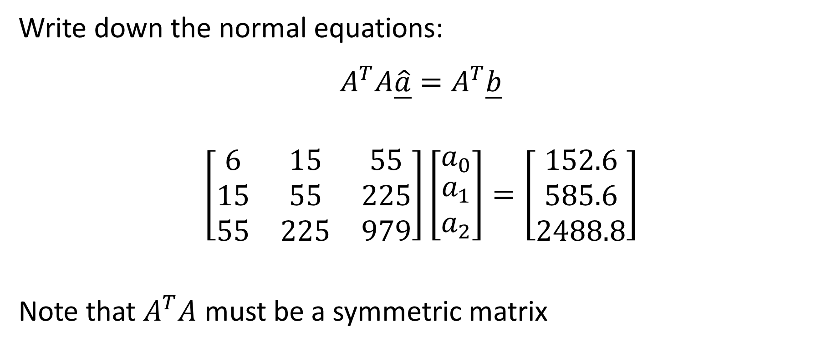
Example – Step 2
Write down the normal equations:
$$A^{T}A\underline{\hat{a}}=A^{T}\underline{b}$$
$$\left[\begin{matrix}6 & 15 & 55 \\ 15 & 55 & 225 \\ 55 & 225 & 979\end{matrix}\right]\left[\begin{matrix}a_{0} \\ \begin{aligned}a_{1} \\ a_{2}\end{aligned}\end{matrix}\right]=\left[\begin{matrix}\begin{aligned}152.6 \\ 585.6 \\ 2488.8\end{aligned}\end{matrix}\right]$$
Note that $A^{T}A$ must be a symmetric matrix
Notes:
Having the matrix A and vector b, we can write downs the normal equations
Try it by yourself
You should obtain the displayed equation
Note again that $A^{T}A$ is a symmetric matrix

Slide 21


Example – Step 3
Solve the normal equations to find optimal model parameters:
$$\left[\begin{matrix}a_{0} \\ \begin{aligned}a_{1} \\ a_{2}\end{aligned}\end{matrix}\right]=\left[\begin{matrix}\begin{aligned}2.4786 \\ 2.3593 \\ 1.8607\end{aligned}\end{matrix}\right]$$
$$y=2.4786+2.3593x+1.8607x^{2}$$
Notes:
Solving the normal equations gives us the values for a0, a1 and a2 which will minimize the backward error of the system of inconsistent equations or equivalently which will minimize the squared error
As you can note from the graph, the obtained quadratic function fits indeed as good as possible the data set

Slide 22

Summary
To fit a model by least square:
Write the set of inconsistent equations $A\underline{a}=\underline{b}$ resulting from applying the model to all data points
Solve the normal equations
$$A^{T}A\underline{a}=A^{T}\underline{b}$$
to find the parameters $\underline{\hat{a}}$ of the model which minimize the squared error SE
Notes:
Let us summarize the key findings
To fit a model by least square on has
First to write down the set of inconsistent equations $A\underline{a}=\underline{b}$ resulting from applying the model to all data points
And second toe solve the normal equations $A^{T}A\underline{a}=A^{T}\underline{b}$ to find the parameters $\underline{\hat{a}}$ of the model which minimize the squared error SE

